Slide 1
Serializable objects
Design and possible & necessary additions & modifications
Benefits:
Common way of saving/loading/transmitting objects in .mat files, Horace proprietary formats and serial pipes (MPI)
Standard way of supporting class versions
Simple modifications to make new object serializable.
Possibility to organize efficient serialization and hide internal state (e.g. caches).
Requirements:
Empty Constructor.
Public interface (set of properties) allowing to define state of the object
Inconvenience (Problem?):
Interconnected properties to set for object to be valid. E.g.: s,e,npix have to be the same size

Slide 2
Define interdependent properties. Solutions:
Special serializable interface different from normal public interface:
Good:
May be more efficient from point of view of serialization& IO operations
Bad:
Interface overcomplication. Non-trivial operations may be necessary for set-up
e.g.: dnd se_npix property
e.g.: orho_proj uvwp property:
Separate interdependent properties validator & isvalid property:
Bad:
May be less efficient (Mitigated by introducing hidden public efficient interface).
Object may become invalid if not all public properties are set
Good:
Natural way of working & exploring the object
Additional benefits (see later)

Slide 3
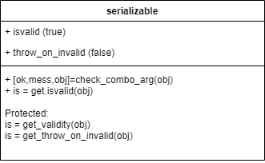
Serializable validity:
Any class which want to check validity:
Defines check_combo_arg
Defines get_validity(obj) -- return isvalid_ private value
Any combo property setter have last operation:
[~,~,obj] = check_combo_arg(obj); % may return invalid
% obj
4) A constructor has last operation:
[ok,mess,obj] = check_combo_arg(pobj)
if ~ok
error(,mess);
end

Slide 4
Additional benefit of serializable interface:
Problem: Various complex constructors, difficult to understand and modify.
Solution: Standard constructor in the form:
obj(pos_value,pos_value,pos_value…,
’-key1’,value,’-key2’,value’…)
key -- the pubic properties names.

Slide 5
Do we want standard eq operator?
Problem: generic equal currently goes trough struct
Serializable interface specifies the properties, which fully define the state of the object, so comparing their values gives clear conclusion of the objects equality.

